Slide 1
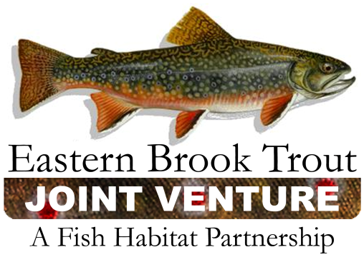
Northern Workgroup Update
Annual Partnership Meeting
October 26 – 28, 2010
Pembroke, Virgina

Slide 2
Northern Region Habitat Objectives
By 2012:
Maintain status/no net loss of 477 healthy subwatersheds
Strengthen populations in 50 subwatersheds
Reestablish a population in 1 subwatershed classified as extirpated
Prevent further degradation in 505 reduced subwatersheds
Gather info on 700 predicted subwatersheds
Lakes and ponds: No net loss; And, assess status of 50 unknown waters
Notes:
Because brook trout are fairly ubiquitous in at least parts of many of the NE states, we had earlier agreed that most of our effort would be towards:
Evaluating what we have – filling in the subwatersheds where there is no recent, quantitative data, and
Protecting what we have. No net loss of healthy HUCs should be number one priority.
First objective targets currently healthy subwatersheds – maintain the status, or no net loss, of 477 of those.
Fourth objective targets reduced subwatersheds – prevent further degradation
Also aim to gather info on 700 subwatersheds.
Strengthen populations – habitat restoration projects – 50 subwatersheds
Reestablish one population
Added objective for lakes and ponds
Issue: Have not incorporated PA objectives into ours. Need to revise these.
Also, we had suggested in the past changing the target date from 2012 to 2020.

Slide 3
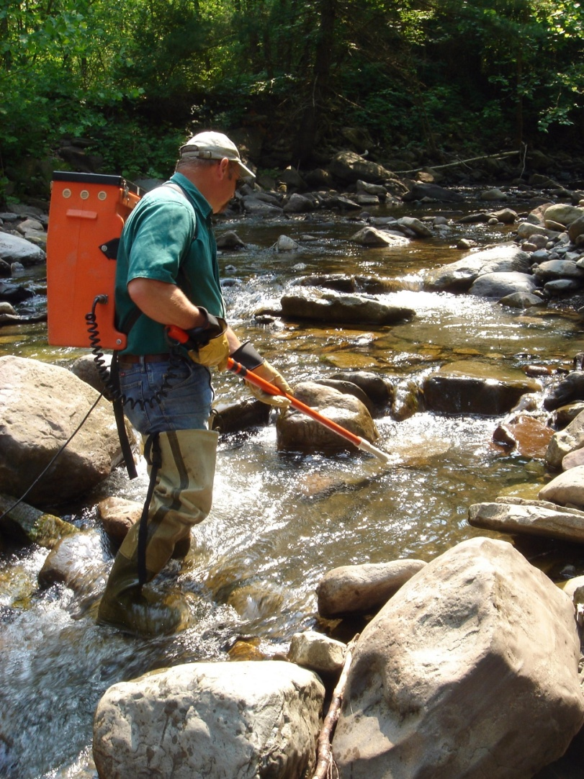
New York
Status surveys in streams
Brook trout restoration in lakes and ponds: reclamation, liming, broodstock waters
Habitat improvement projects

Slide 4
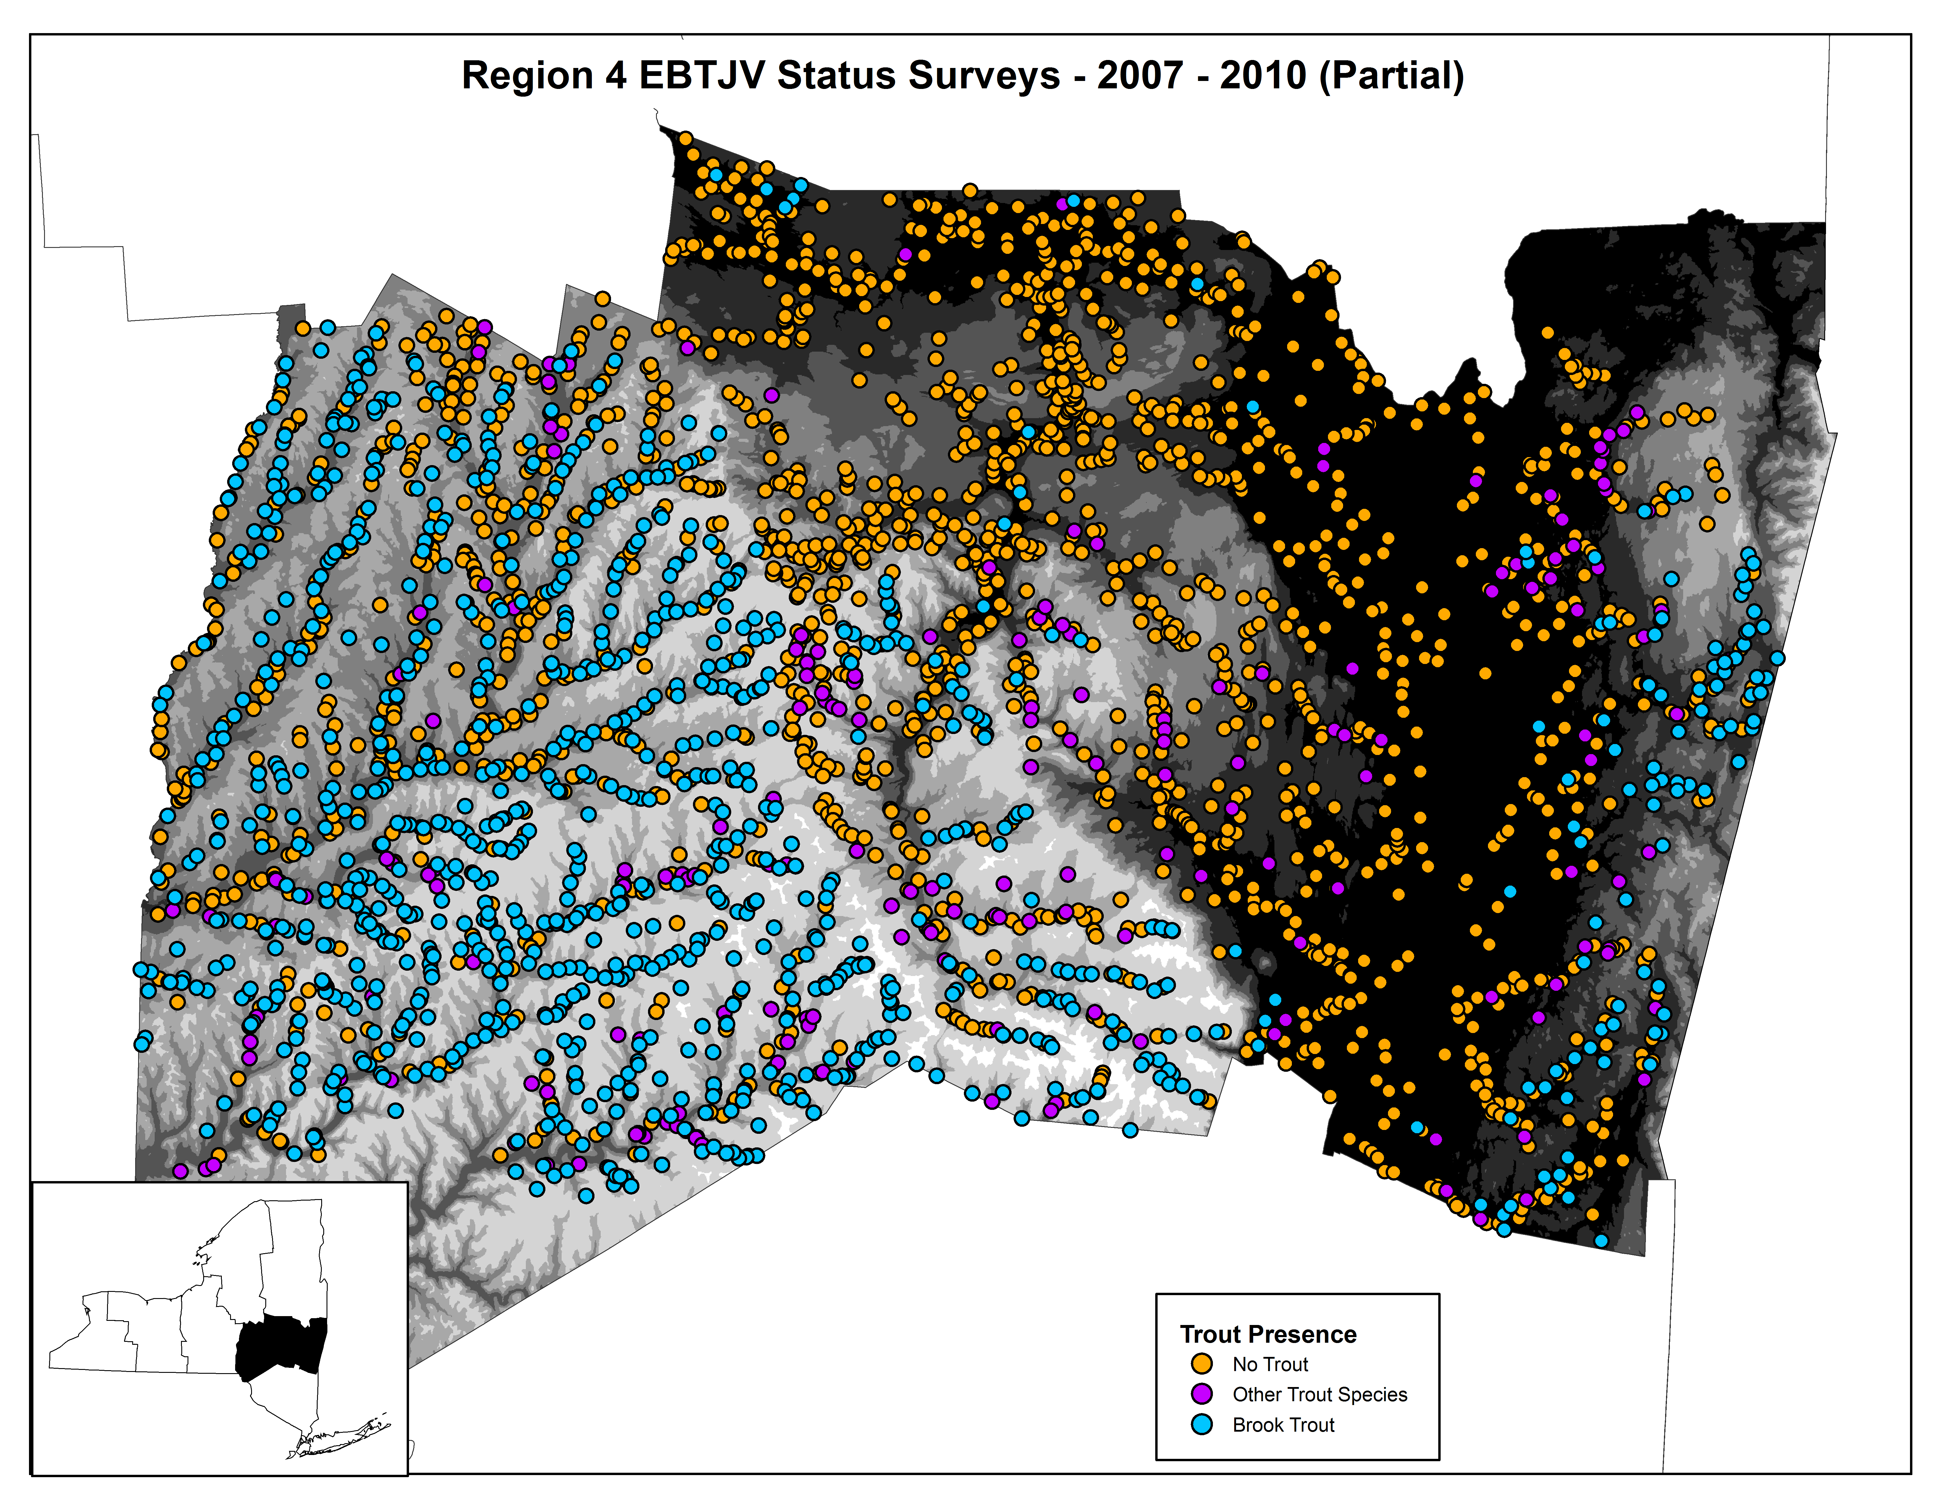
Notes:
DEC Region 4 – largest effort.
Started in 2007
Map – shows location of sampling vs elevation. Blue – where brook trout were found. Most sampling at mouths of tribs.
Over the first three years of the project, we have sampled over 2,000 streams
Over 700 of these had brook trout in them.
335 streams had no record of trout in them – not protected under NYS regulations. No eligible for protection.

Slide 5
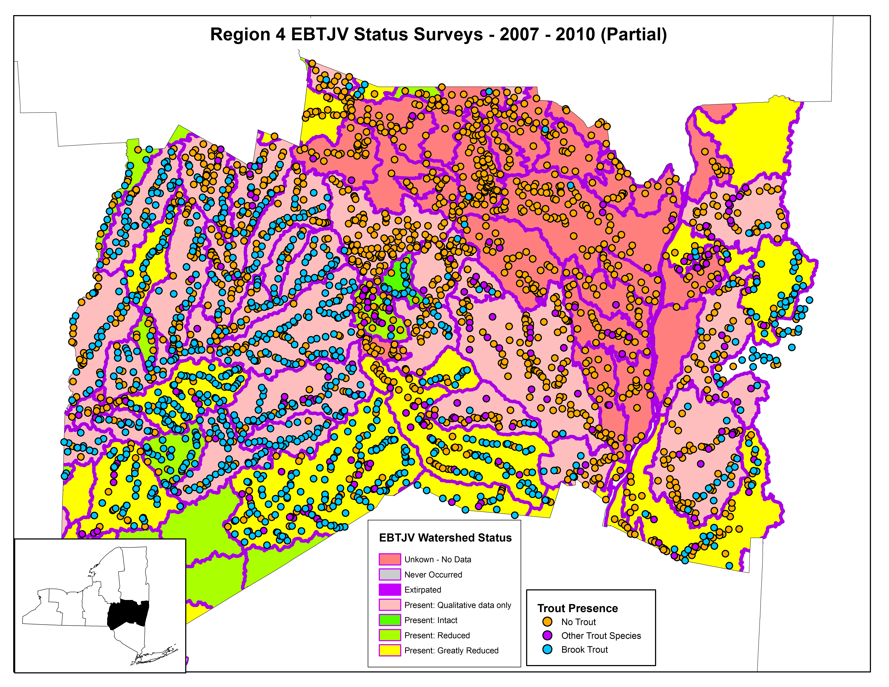
Notes:
Plotted against the EBTJV status assessment.
Filling in the blanks – (red and pink) – 56 subwatersheds that had no current data now do.
New data for 80 subwatersheds – some of which will have classifications upgraded.

Slide 6
Northern Region Habitat Objectives
By 2012:
Maintain status/no net loss of 477 healthy subwatersheds
Strengthen populations in 50 subwatersheds
Reestablish a population in 1 subwatershed classified as extirpated
Prevent further degradation in 505 reduced subwatersheds
Gather info on 700 predicted subwatersheds
Lakes and ponds: No net loss; And, assess status of 50 unknown waters
Notes:
Meets several objectives…
Was expanded to other regions. In region 9, unexpected benefit – found streams do not contain trout, but have recovered and now appear to be able too. Makes restablishment of populations more feasible?

Slide 7
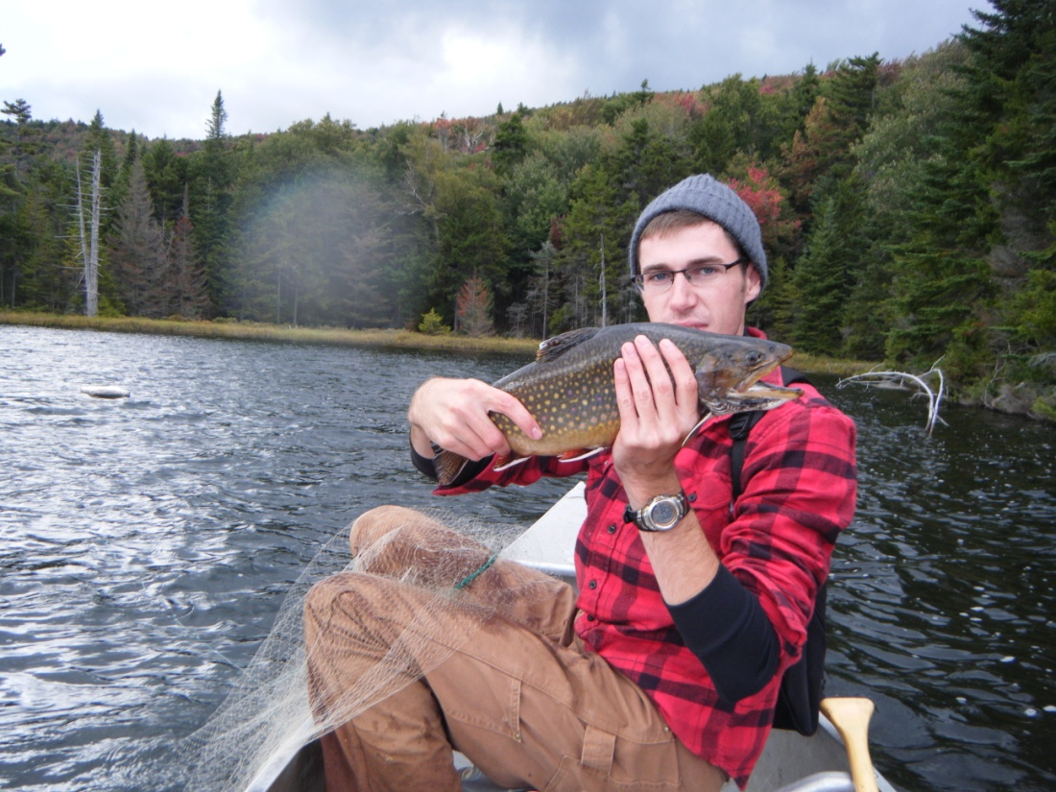
Adirondack Lakes and Ponds
Notes:
Active management program in the Adirondacks for lakes and ponds:
Surveys to determine status and effectiveness of management actions
Pond reclamations to remove invasive species – will have reclaimed several in this time period
Maintenance of broodstock waters, propagation of heritage strains in hatcheries, restocking
This is a Horn Lake strain brook trout captured in Brooktrout Lake. Brooktrout Lake has recently recovered on it’s own from acid precipation (was fishless). No supports reproduction population of heritage-strain brook trout.

Slide 8
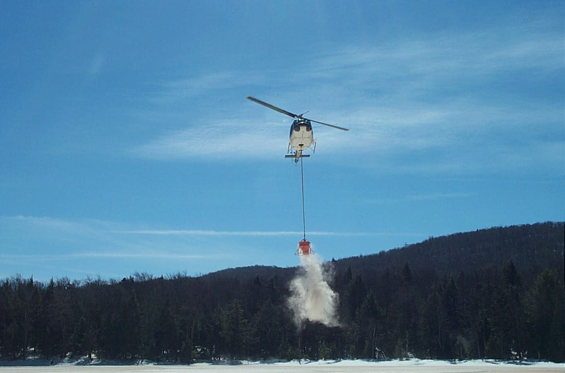
Notes:
Also have a liming program, primarily in the SW Adirondacks. Annual monitoring and liming as needed. Generally spread over ice in winter.

Slide 9
Northern Region Habitat Objectives
By 2012:
Maintain status/no net loss of 477 healthy subwatersheds
Strengthen populations in 50 subwatersheds
Reestablish a population in 1 subwatershed classified as extirpated
Prevent further degradation in 505 reduced subwatersheds
Gather info on 700 predicted subwatersheds
Lakes and ponds: No net loss; And, assess status of 50 unknown waters
Notes:
Can fit into other objectives, but directly supports the last one. Trying to get access to West Canada Lake Wilderness so survey many unknown waters that may be recovering from acid precip.

Slide 10
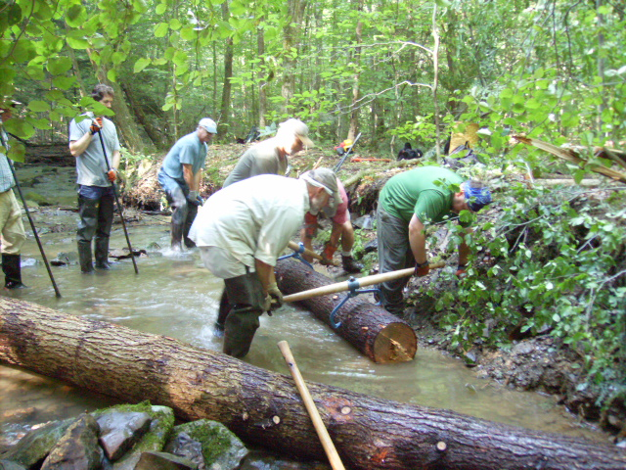
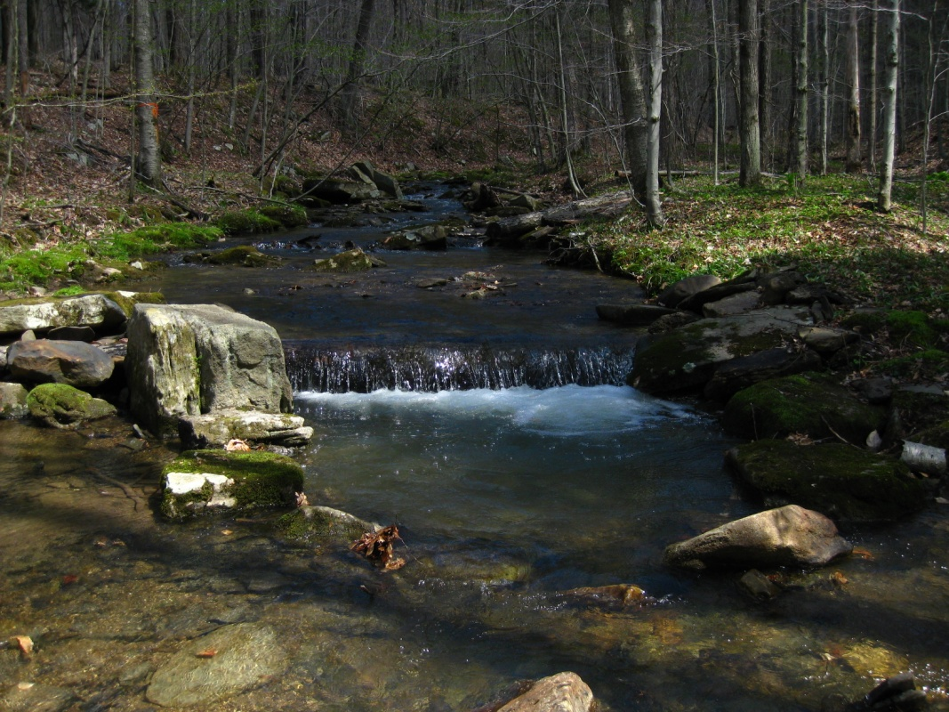
McIntosh Brook
Notes:
Strengthening of populations – don’t do many habitat projects
McIntosh Brook – Allegany State Park.
Cooperative effort with two local TU chapters
Low summertime flows – lack of pools; lack of LWD in a secondary forest
Project to boost summer habitat in a 1.5 mile stretch
Funded with EBTJV funds
16 log structures to scour pools
Fish populations will be evaluated for changes over the next several years

