Slide 1
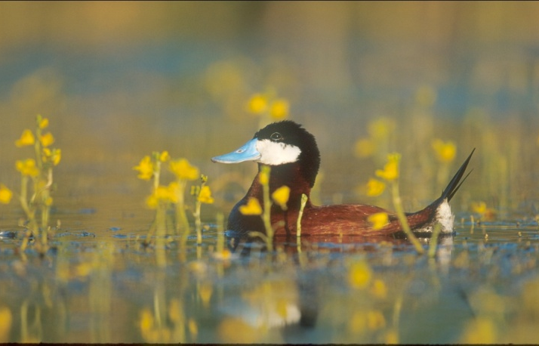
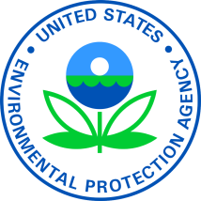




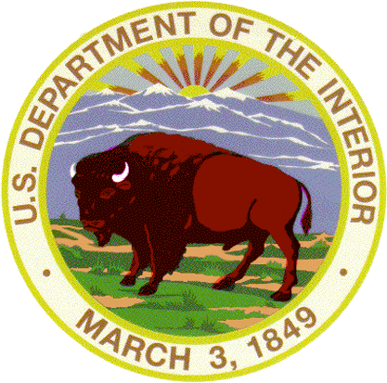
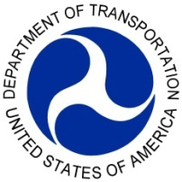
Executive Order 13508
Strategy for
Protecting and Restoring the
Chesapeake Bay Watershed
For EBTJV meeting
October 26, 2010
Notes:
Senior Administration officials from each of 7 departments gathered May 12 to roll out the strategy worked on over the past year

Slide 2
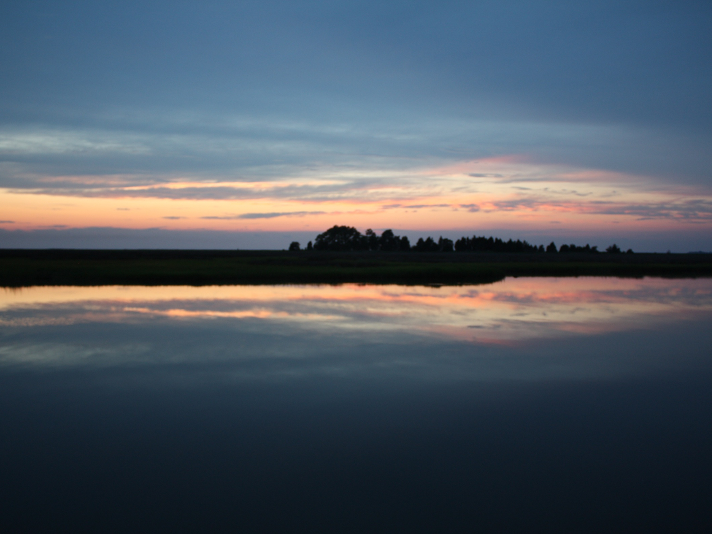
Vision: A Chesapeake watershed with:
Overview
Executive Order 13508 (May 2009)
Strategy, Goals and Outcomes (May 2010)
Action Plan (September 2010)
Needs and Opportunities
Notes:
With focus on the brook trout outcome and specific actions related to brook trout

Slide 3
Executive Order 13508
Issued May 12, 2009 to “protect and restore the health, heritage, natural resources, social and economic value of the nation’s largest estuarine ecosystem and the natural sustainability of its watershed.”
Established a Federal Leadership Committee (FLC)
Called for coordinated strategy within one year
Requires annual Action Plan and Progress Report
Strong support from CEQ and DOI throughout process
Notes:
and ushered in new era of shared federal leadership, action and accountability
FLC chaired by EPA Administrator and including senior representatives of the departments of Agriculture, Commerce, Defense, Homeland Security, Interior and Transportation.
Tasked FLC with preparing strategy and submitting within one year

Slide 4
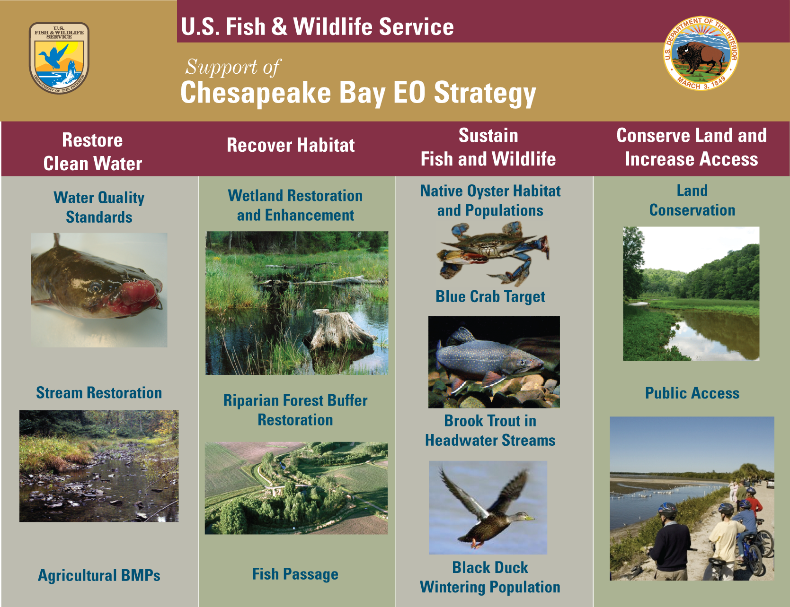
Notes:
Strategy is structured with 4 goals and 12 associated environmental outcomes as seen here

Slide 5
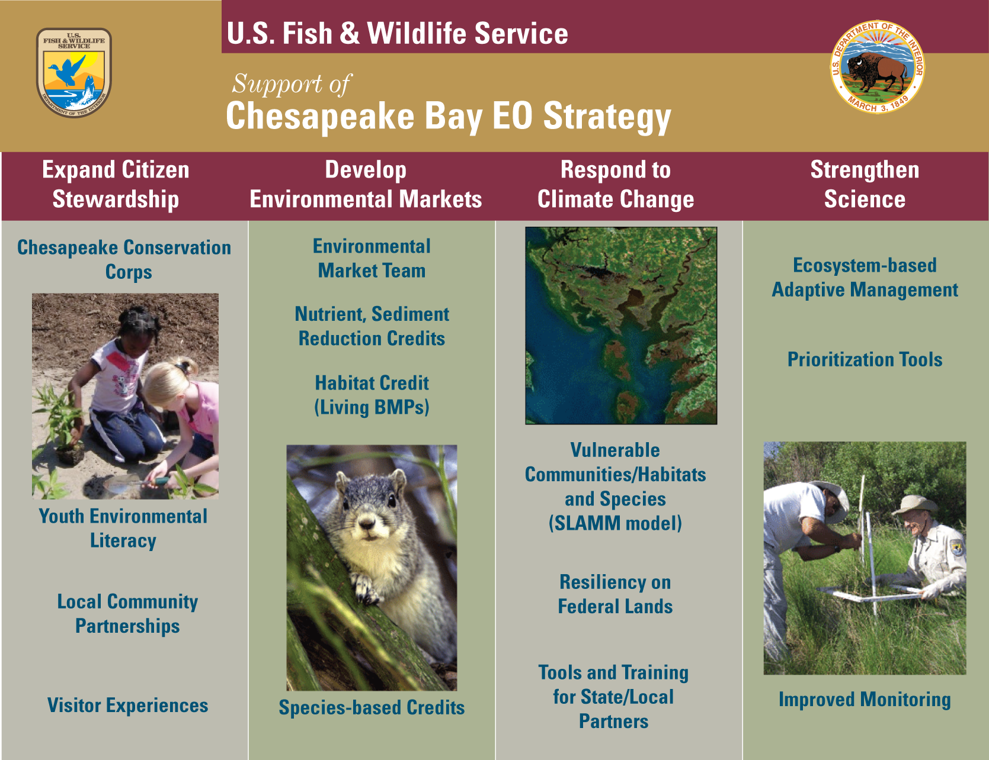
Notes:
also laid out 4 ‘supporting strategies’

Slide 6
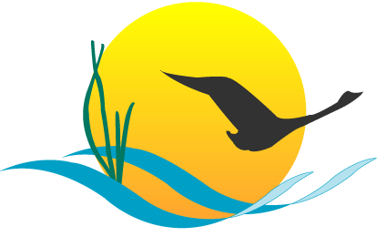
Restore Clean Water
GOAL:
Reduce nutrients, sediment and other pollutants to meet Bay water quality goals for dissolved oxygen, clarity and chlorophyll-a and toxic contaminants.
WATER QUALITY OUTCOME:
Meet water quality standards for dissolved oxygen, clarity/underwater grasses and chlorophyll-a in the Bay and tidal tributaries by implementing 100 percent of pollution reduction actions for nitrogen, phosphorus and sediment no later than 2025, with 60 percent of segments attaining standards by 2025.
STREAM RESTORATION OUTCOME:
Improve the health of streams so that 70 percent of sampled streams throughout the Chesapeake watershed rate three, four, or five (corresponding to fair, good or excellent) as measured by Index of Biotic Integrity, by 2025.
AGRICULTURAL CONSERVATION OUTCOME:
Work with producers to apply new conservation practices on 4 million acres of agricultural working lands in high-priority watersheds by 2025 to improve water quality in the Chesapeake Bay and its tributaries.
Notes:
WQ Actions:
establish and implement the Chesapeake Bay TMDL: water quality standards for N/P/S
Ensure that all practices to meet Bay water quality standards are in place by 2025.
Strengthen regulations, enforcement and compliance
Funding - Provide additional state grants for regulatory and accountability programs.
Toxic contaminants – Identify actions to reduce impact of toxic contaminants.
improve science to prioritize, monitor and evaluate water-quality actions and improvement in the Bay and its watershed and support adaptive management.
Federal Facilities and Lands – Reduce point and nonpoint source stormwater discharges to contribute to load reduction goals for each jurisdiction.
Streams:
funding for stream restoration
Expand IBI beyond benthos

Slide 7
Recover Habitat
GOAL:
Restore a network of land and water habitats to support priority species and to afford other public benefits, including water quality, recreational uses and scenic value across the watershed.
WETLANDS OUTCOME:
Restore 30,000 acres of tidal and non-tidal wetlands and enhance the function of an additional 150,000 acres of degraded wetlands by 2025.
FOREST BUFFER OUTCOME:
Restore riparian forest buffers to 63 percent, or 181,440 miles, of the total riparian miles (stream bank and shoreline miles) in the Bay watershed by 2025.
FISH PASSAGE OUTCOME:
Restore historical fish migratory routes by opening 1,000 additional stream miles by 2025, with restoration success indicated by the presence of river herring, American shad and/or American eel.
Notes:
Wetlands current condition: 1 million acres of tidal and non-tidal wetland estimated to be available in the Chesapeake watershed for restoration or enhancement. Between 1998 and 2008, 18,217 acres of wetlands were restored and 97,738 acres were enhanced.)
Forest Buffer current condition: 58 percent of the 288,000 total riparian miles in the Bay watershed has forest buffers in place.
Fish Passage current condition: Approximately 1,924 miles in the Chesapeake Bay watershed have been opened and are accessible for fish migration. Projects are currently being ranked and prioritized through a collaborative federal and state process designed to strategically target priority projects. Number of miles opened per project is a key criterion in the prioritization process.)

Slide 8
Sustain Fish and Wildlife
GOAL:
Sustain healthy populations of fish and wildlife which contribute to a resilient ecosystem and vibrant economy.
OYSTER OUTCOME:
Restore native oyster habitat and populations in 20 tributaries out of 35 to 40 candidate tributaries by 2025.
BLUE CRAB OUTCOME:
Maintain sustainable blue crab interim population target of 200 million adults (1+ years old) through 2025.
BROOK TROUT OUTCOME:
Restore naturally reproducing brook trout populations in headwater streams by improving 58 sub-watersheds from ‘reduced’ classification (10-50% of habitat lost) to ‘healthy’ (less than 10% of habitat lost) by 2025.
BLACK DUCK OUTCOME:
Restore a three-year average wintering black duck population in the Chesapeake Bay watershed of 100,000 birds by 2025.
Notes:
Oysters - current condition: 0 tributaries with fully restored oyster populations, several tributaries with successful living oyster reef habitat.
Blue Crab current condition: 2007-2008: 131 million; 2008-2009: 223 million; 2009-2010: 315 million.
Brook Trout current condition: 388 of 1294 sub-watersheds in Chesapeake Bay currently classified as ‘reduced’ for brook trout.
Black Duck current condition: Recent mid-winter aerial surveys estimate the 2007-2009 rolling three-year average at 37,158 black ducks in the Chesapeake Bay.

Slide 9
Actions Specific to Brook Trout http://executiveorder.chesapeakebay.net/category/Reports-Documents.aspx
FW6: Restore stream habitat through partnerships
1. Develop and implement high priority stream passage and barrier removal projects throughout the watershed, focusing on brook trout habitat. Restore/enhance 10 miles brook trout habitat; consistent with the goals and objectives of the EBTJV.
2. Develop and implement habitat restoration projects, focusing on improving water quality (e.g. pH) and restoring natural stream structure and function in 4-8 sub-watersheds.
Notes:
Note: All of these are to be done by September 2011

Slide 10
Brook Trout actions, continued
FW7: Consider climate change in prioritizing sub-watersheds for restoration
1. Develop a database and framework to identify and prioritize site specific brook trout restoration and conservation projects.
FW14: Improve scientific information on selected freshwater species
2. Conduct drainage-level assessments of genetic differentiation (shad, brook trout, FW mussels) to help identify appropriate management units and guide restoration strategies in terms of location and scale.

Slide 11
Brook Trout actions, continued
FW16: Establish watershed program for brook trout monitoring
1. Work with states to establish program for brook trout monitoring in the watershed. Coordinate habitat assessment, stream surveys, and long-term monitoring.
2. USGS will work with FWS to determine if existing stream monitoring can be enhanced to address monitoring of habitat conditions for brook trout.

Slide 12
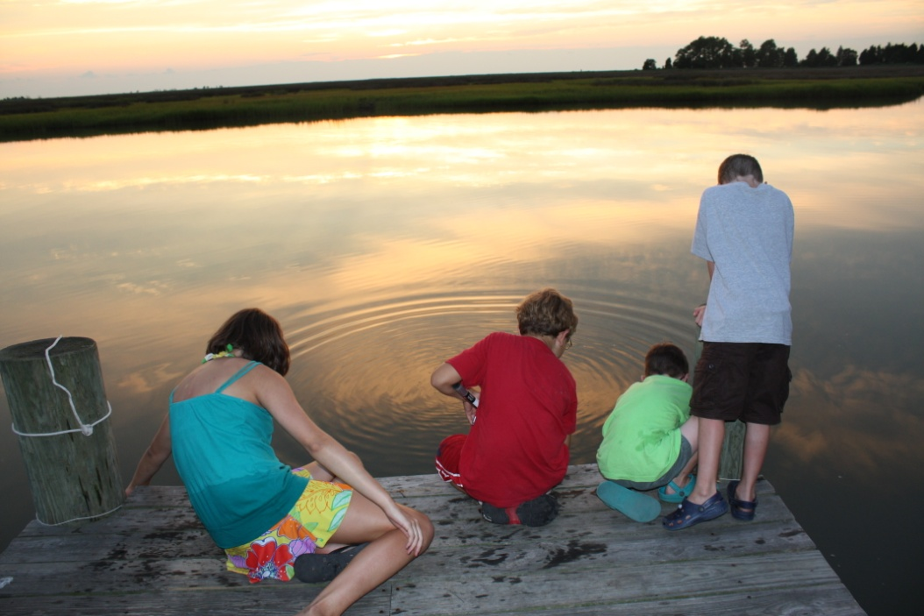
Needs and Opportunities
Indicator and Two Year Milestones
For use in annual progress report
Subset of EBTJV watershed status data for Chesapeake Bay
Increased monitoring to for accountability; align with stream outcome?
Targeting
Identify 5 sub-watersheds to focus on in FY11
One in each state (VA, WV, MD, PA, and NY)
Align with climate resilience, State WIP pilots, NRCS priority watersheds?
Funding
$421,408 new FWS funds in FY11
Apply for NRCS CCPI grant
NFWF keystone species
Awareness Building
FWS Chesapeake Bay website
CBP Chesapeake Stat online tool
Link to LCC work?
12
Notes:
12

Slide 13
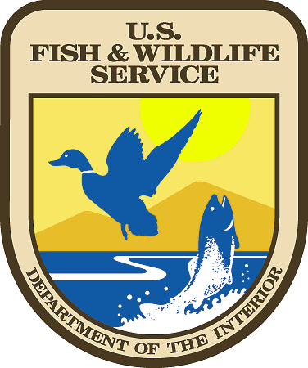

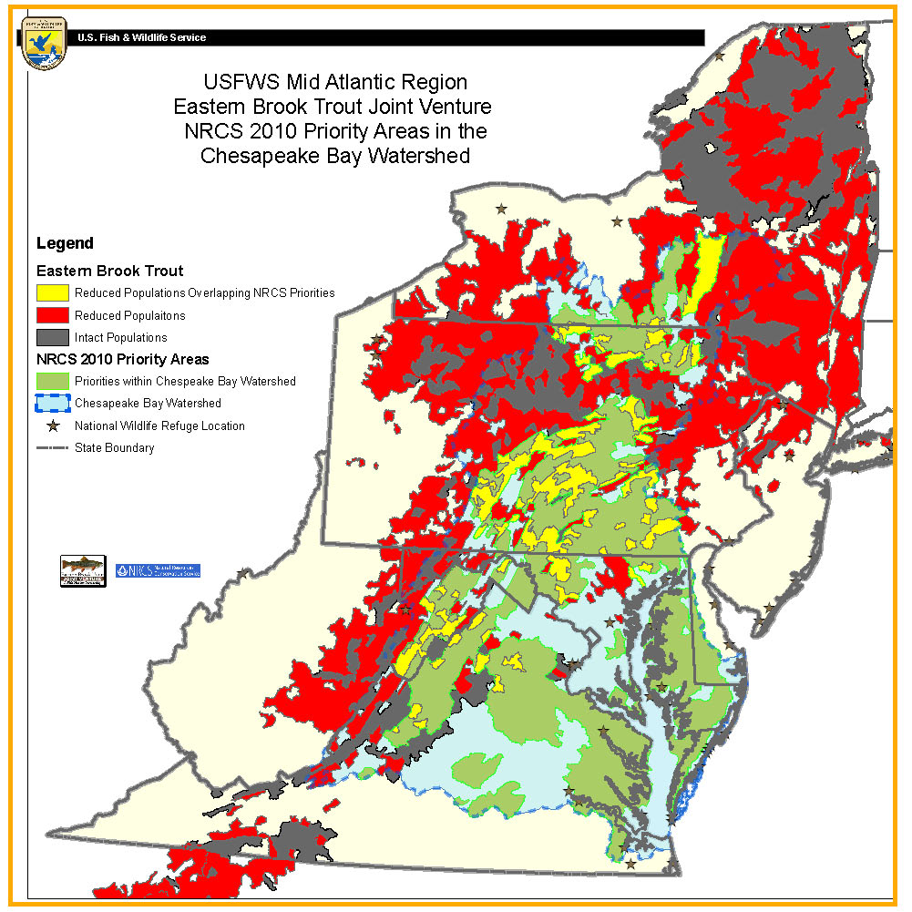
US Fish & Wildlife Service
Natural Resources
Conservation Service
Overlapping Priorities Between:
Eastern Brook Trout Reduced/Intact Population Areas
NRCS Priority Areas - Chesapeake
Identifying Interagency Priorities
Notes:
Note: NRCS priority areas are overlap of high N/P/S loadings and highly erodeable soils
Other possible layers:
State Phase 2 WIP pilots
FWS focus areas
Results of Mark Hudy’s work on resilience to climate change

