Slide 1
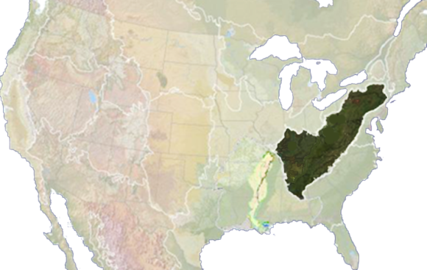
2011-12 Development Process:
Collate stakeholders’ science needs to facilitate landscape conservation = Nov 2011 Science Needs Workshop
Summary of science needs process and outcomes = Workshop Report + Portfolio of Science Needs + Directory of Experts
3. ID and approve funding support for “top” science needs = FY 2011-12 Request for Applications
4. Complete stakeholder interviews and host July 2012 Workshop for ISC to develop conservation targets = 3-5 year work plan for the AppLCC *
Jean Brennan Coord. jean_brennan@fws.gov; Bridgett Costanzo, Sci. Coord. bridgett_costanzo@fws.gov

Slide 2
Joint Actions: AppLCC and EBTJV
EBTJV has ISC membership and has served on science needs workshop planning team and on technical review/advisory teams
EBTJV provided science needs priority list to AppLCC for use at Nov. 2011 Priority Conservation Science Needs Workshop at VA Tech and inclusion in AppLCC Portfolio of Science Needs
AppLCC is applying FY11-12 funds to four science products that will inform EBT conservation
Shared/companion website design to facilitate ease of use, coordinated postings, and shared web training

Slide 3
AppLCC - FY11-12 FUNDED PROJECTS
1) Ecological Flows
Title: Developing a Hydrologic Foundation and Flow-ecology Relationships for Monitoring Riverine Resources in the Marcellus Shale Region
Organization: Cornell University (P.I. - Fisher)
2) Aquatic Habitat Classification
Title: A Stream Classification System for the Appalachian LCC
Organization: The Nature Conservancy ( P.I.s – Anderson & Oliviera)
3) Forecasting Energy Development
Title: Assessing Future Impacts of Energy Development in the Appalachians
Organization: The Nature Conservancy (P.I.s Kiesecker & Dunscomb)
(note: this project will address coal, gas, and wind)
4) Climate Change Vulnerability Assessments
Title: Support for Understanding Land Use and Climate Change in the Appalachians
Organization: NatureServe (P.I.s Young & Sneddon)

Slide 4
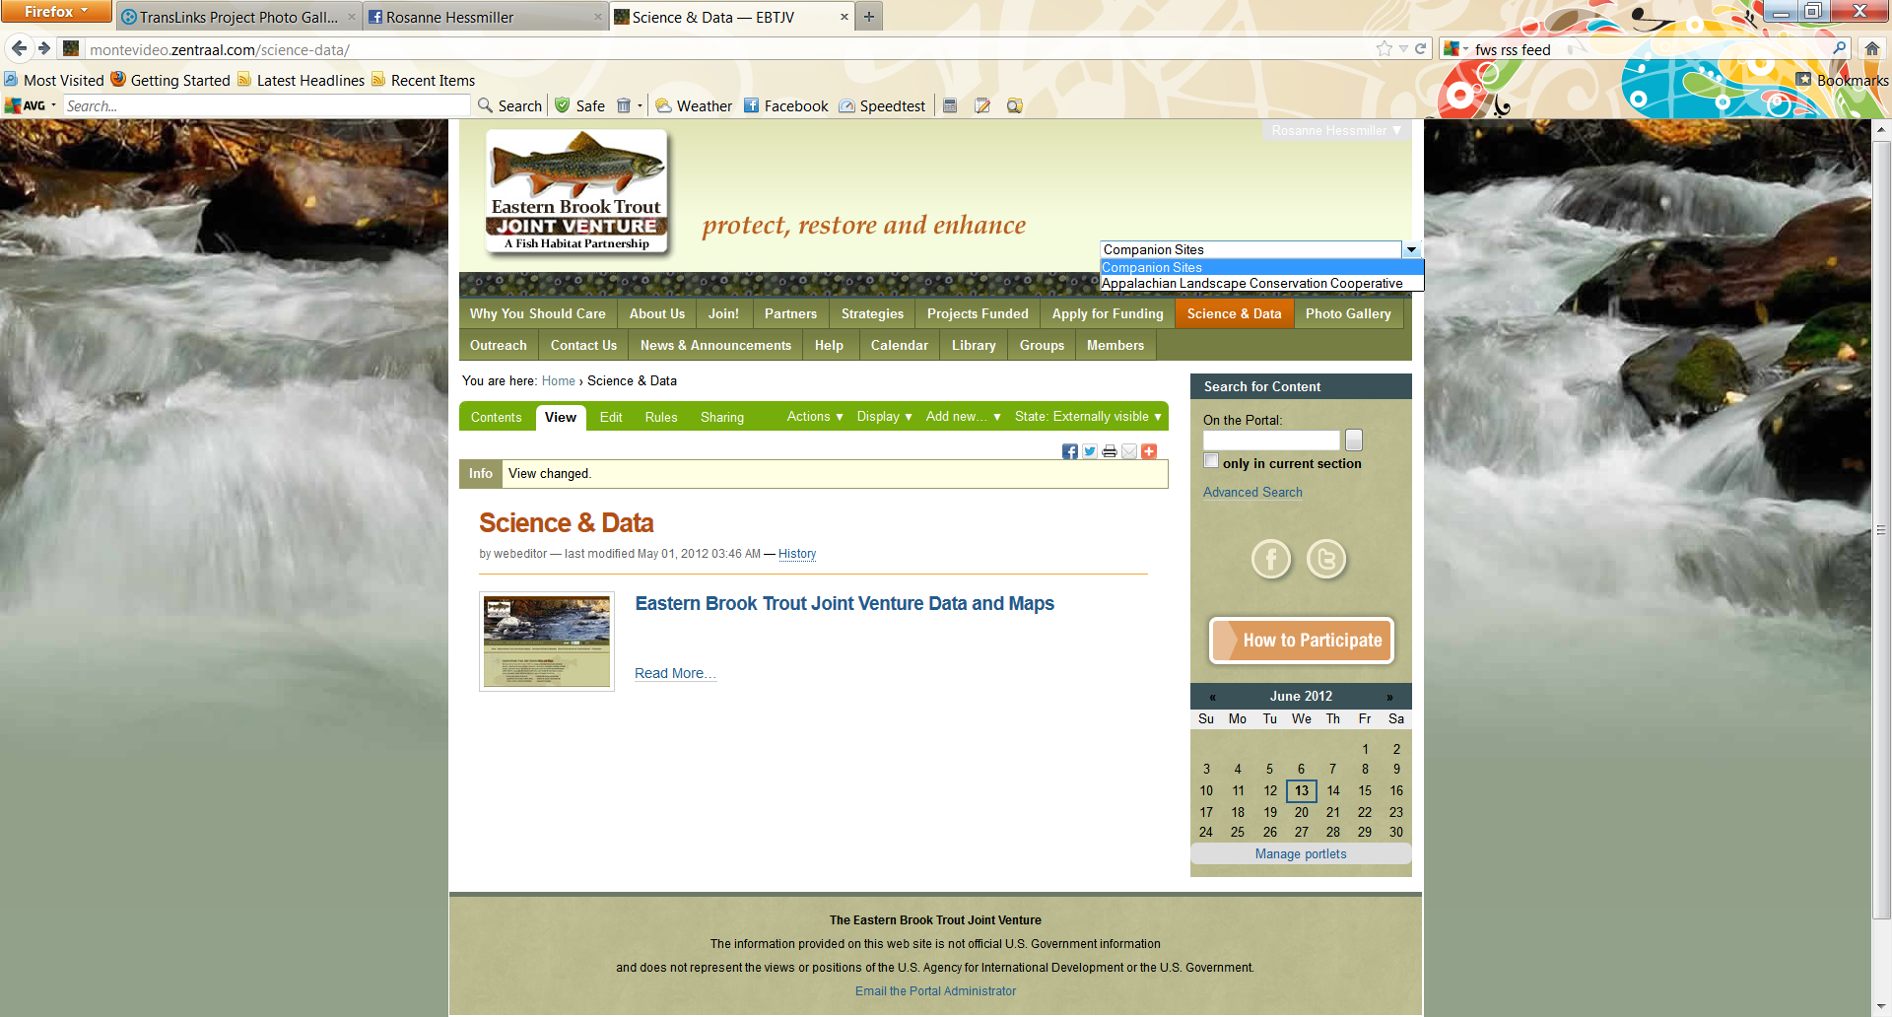
Companion Portal Drop Down to Toggle between LCC portal and Partner Sites

Slide 5
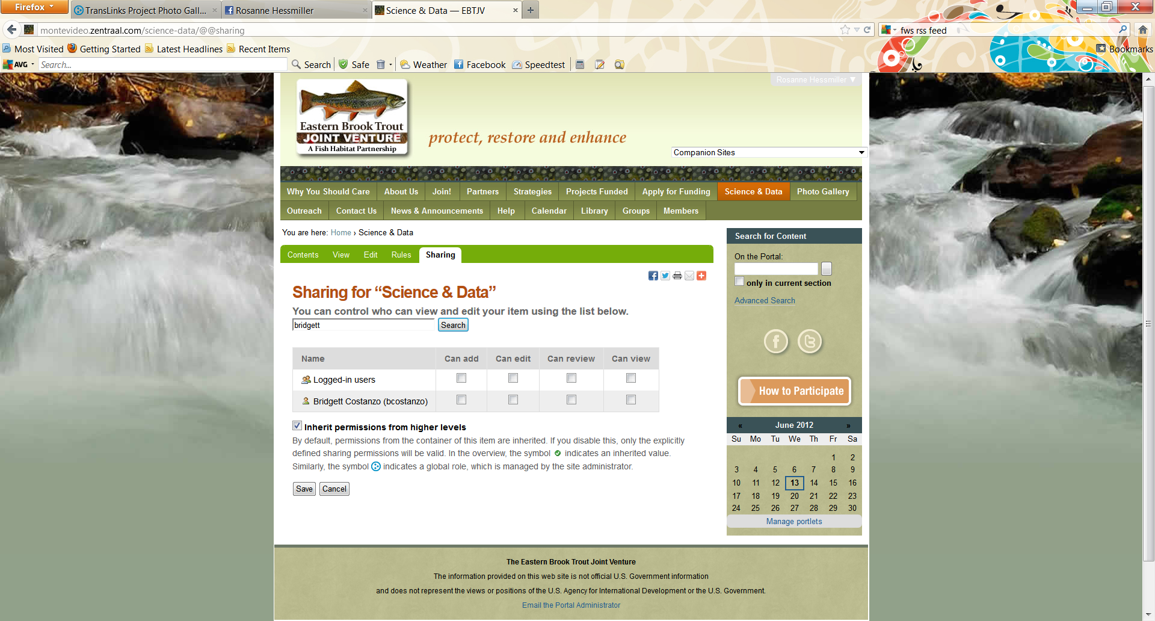
Sharing content with Groups or other Members

