Slide 1
SARP Science and Data Committee Science Projects
Emily Granstaff
USFWS & SARP
October 25, 2013
Joint SARP, EBTJV, and ACFHP Science Calls

Slide 2
BACKGROUND AND ORGANIZATIONAL STRUCTURE

Slide 3
SDC Membership
16 State, Federal, and NGO agencies; plus 2 FHPs and reps from LCCs
Approximately 40 members
  Chair: Will Duncan, USFWS-Athens, GA
Voluntary membership
Monthly conference calls and an Annual meeting

Slide 4
Background on the SARP Science and Data Committee
Directed by Southeast Aquatic Habitat Plan’s Integrated Conservation Strategies
Tasks for the SDC include:
  Identify existing information and data gaps for aquatic
  Encourage integration of relevant data from partners
  Support NFHP Science and Data Committee
  Work towards identifying priority areas
  Identify guidelines on aquatic habitat management tools and practices
  Assess progress towards objective’s targets every 5 years

Slide 5
Organizational Structure of Science and Data Committee
Charged with the responsibilities of making big decisions, developing a vision for SARP, strategizing, using information supplied by Science and Data Committee.
Steering Committee
Charged with the responsibility of providing scientific technical support and expertise to steering committee, conducting habitat assessments and the science behind the strategy, and routinely corresponding with NFHAP and SARP Steering Committee. Committee also includes expertise from Southeastern Fishes Council..
Science and Data Committee
New and ongoing initiatives
Prioritization Tools Committee:
Staffed and partly Funded
Layout completed
Science Needs Document Update: Roger, Scott, Will, Cindy W, Emily GrA,
(Google Docs)
Ad Hoc Team:
Application and Validation of TN/Cumberland Assessment:
Who will lead?
Who will participate?
What is the timeline for completion?
Which objectives will we target
Update of SAHP Targets:
Who will lead?
What is the timeline for completion?
Which objectives will we target
LCC-SARP collaboration Club:
Who will lead? Cathy, Glenn, Peggy, etc.
What is the timeline for completion?
Which objectives will we target?
Whitewater to Bluewater:
Emily Greene, Scott, Emily Granstaff, Will Duncan
Validation Subcommittee:
Tripp, Mark Cantrell, Mary Davis, Will, Mark Scott, Emily Granstaff, Glen, Tom Champlau, Roger, Steve Magnelia, Cathy Phillips
Note: Sub committees are charged with the responsibility of developing good ideas and products, and routinely vetting them with the larger Science and Data Committee. New committees can be added, and old ones removed as necessary.

Slide 6
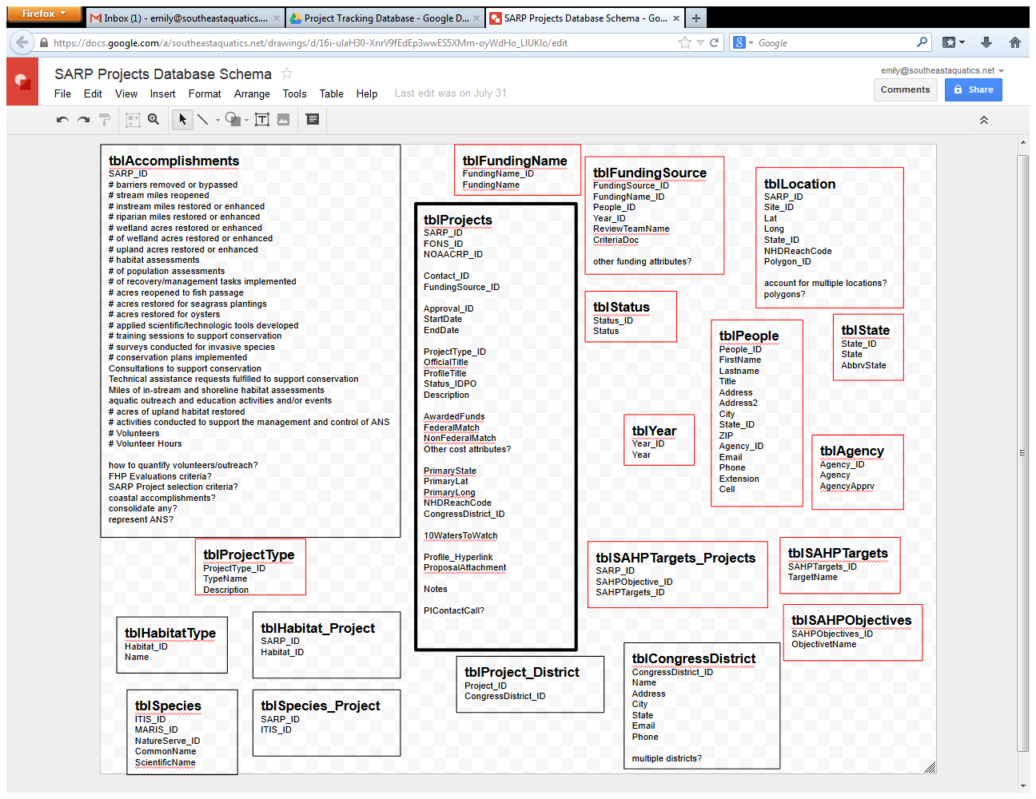
SARP Project Tracking Database

Slide 7
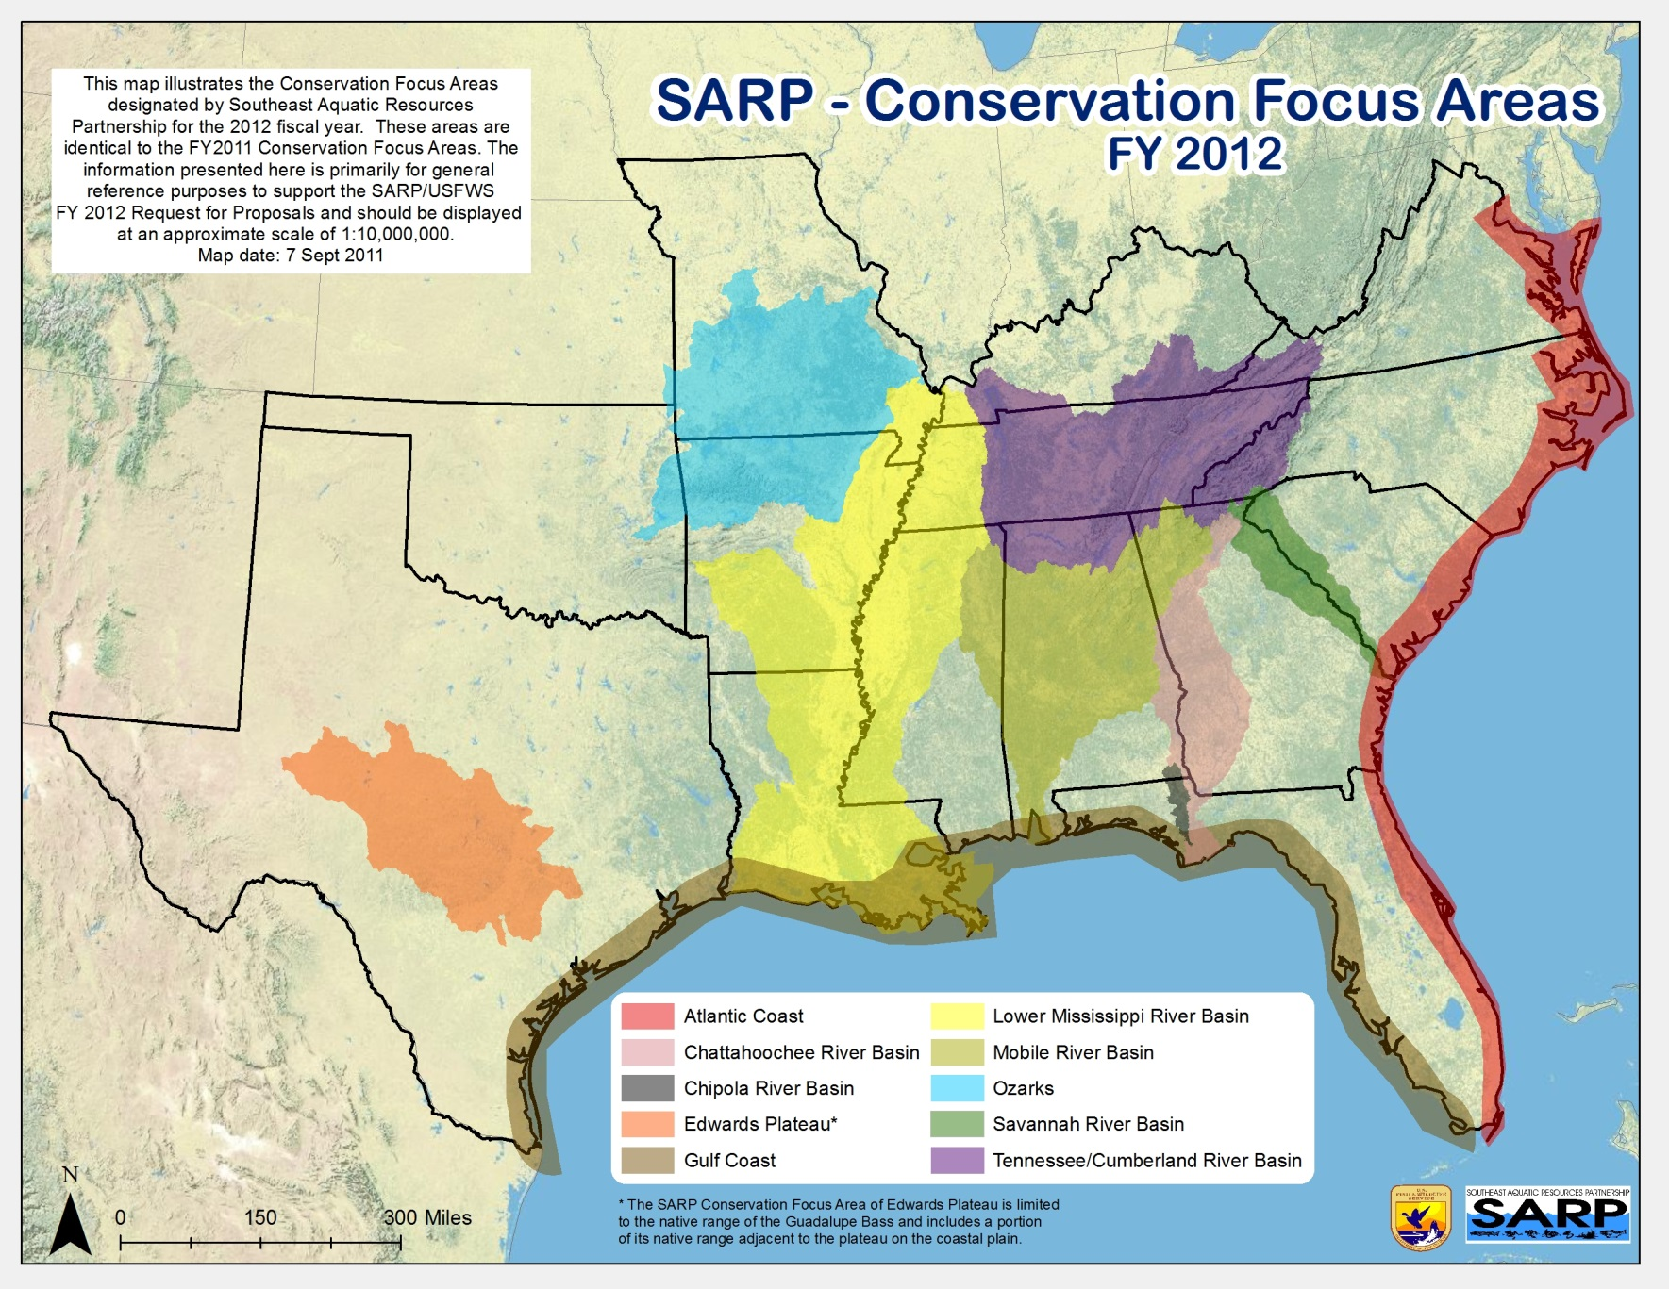
SARP Conservation Focus Areas

Slide 8
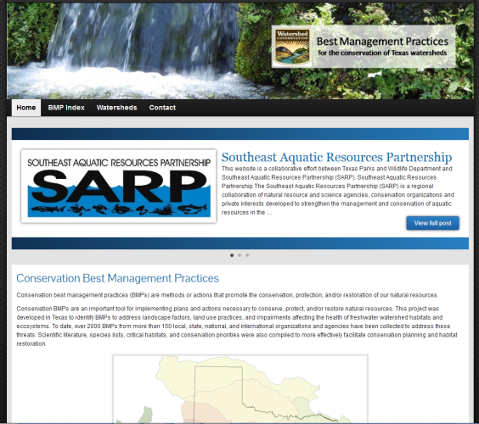
BMP Library

Slide 9
Data Development and Assessments

Slide 10
River Classification
Size Classes, using Cumulative Drainage Area (SARP-wide)
Size Classes, using Mean Annual Flow (SARP-wide)
Gradient Classes (SARP-wide)
Konrad’s hydrologic classification
Ecoregion
FEOW
Annual Precipitation Classes (eastern SARP)
Baseflow Index (eastern SARP)
Runoff Coefficients (MAF in cfs/drainage area) (eastern SARP)
Predicted Hydrologic Variability Class (eastern SARP)
Geologic metrics
Land form metrics
Land cover metrics
Soil water capacity and composition metrics

Slide 11
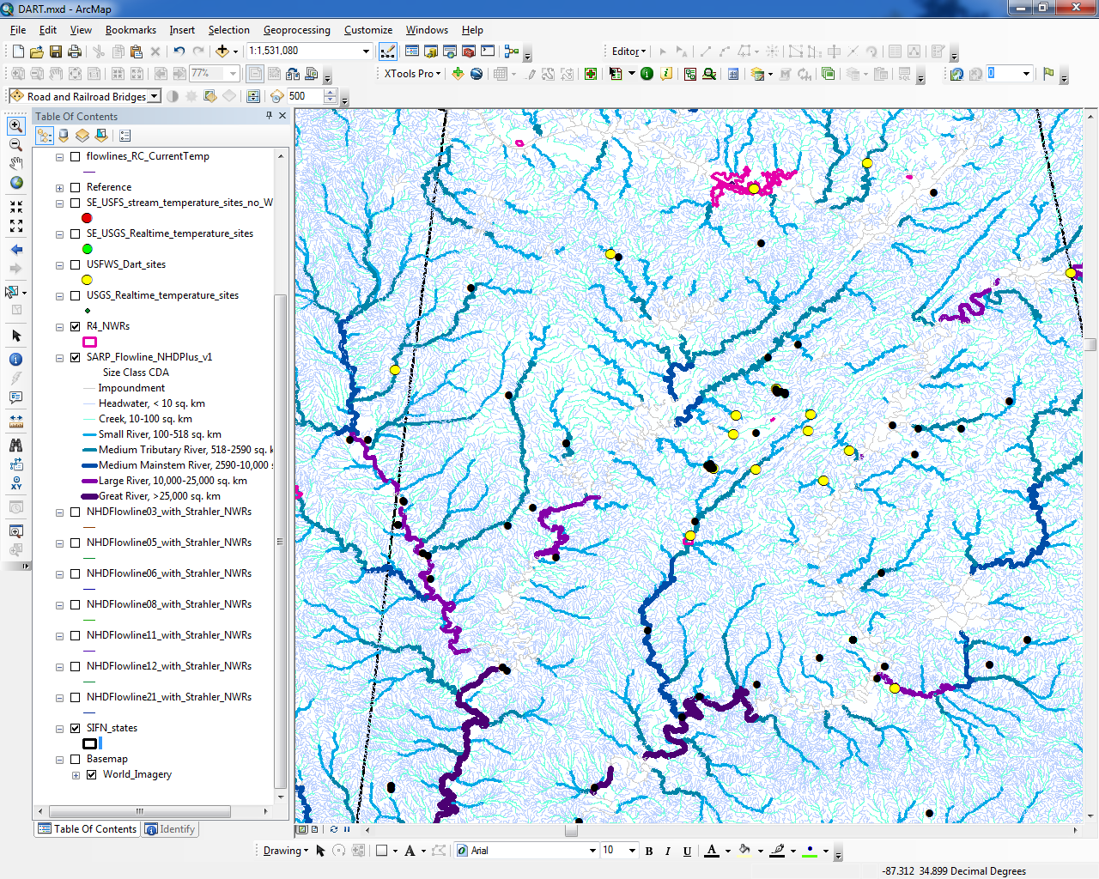
Stream Temperature Logger Sites

Slide 12
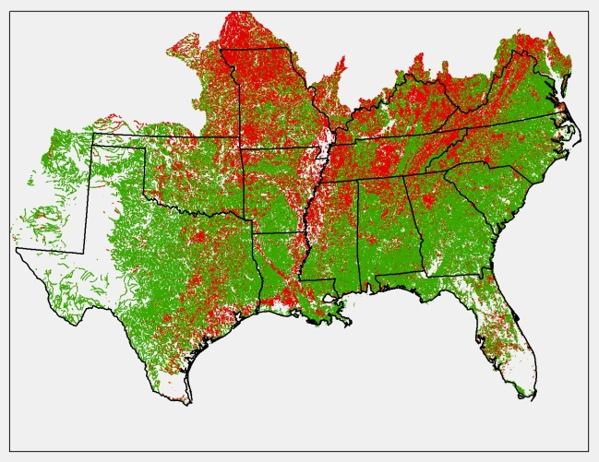
Riparian Assessment

Slide 13
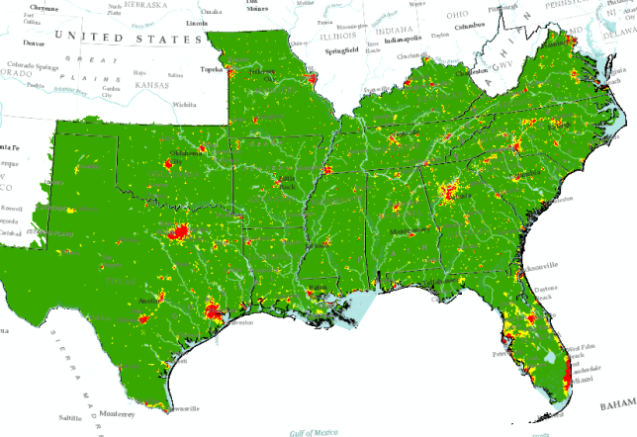
Risk of Flow Alteration Assessment
Risk of Flow Alteration Assessment, v1
  Assesses risk from 3 sources of Flow Alteration:
    Impervious Surface
    Evapotranspiration
    Water Consumption
Risk of Flow Alteration Assessment, v2 (in the works) (TX, OK, LA)
  Updates Water Consumption model

Slide 14
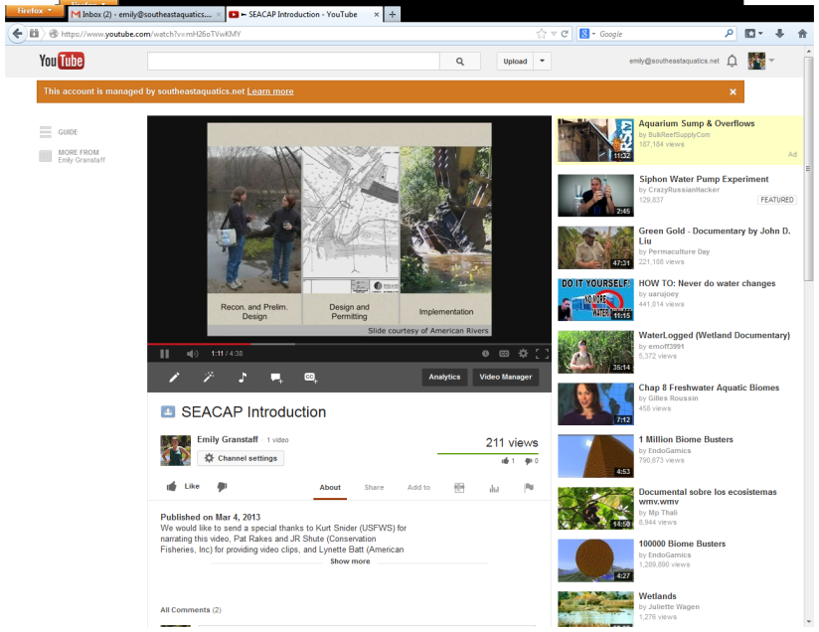
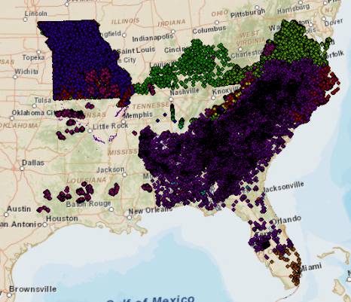
Southeast Aquatic Connectivity Assessment Project (SEACAP)
Southeast Stream Barrier GIS, v1 (SARP-wide)
  Inventory of available GIS datasets of fish barriers
Southeast Aquatic Connectivity Assessment Project and Decision Support Tool (in the works) (eastern SARP)
  Using SSBGIS and other datasets to standardize and linear reference to the NHDPlus for the purposes of inventorying and prioritizing the removal of barriers. Mainly focusing of dams.

Slide 15
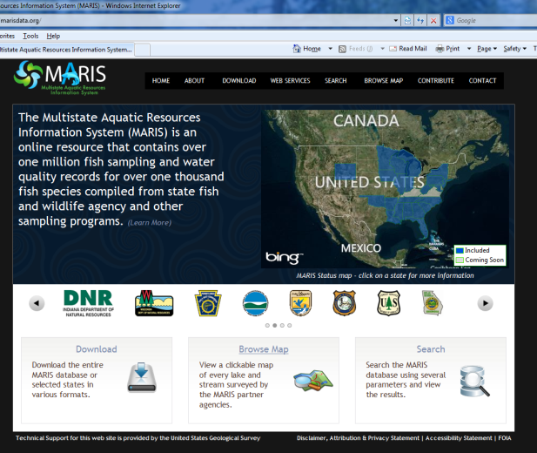
Multistate Aquatic Resources Information System

Slide 16
Native Black Bass Initiative

Slide 17
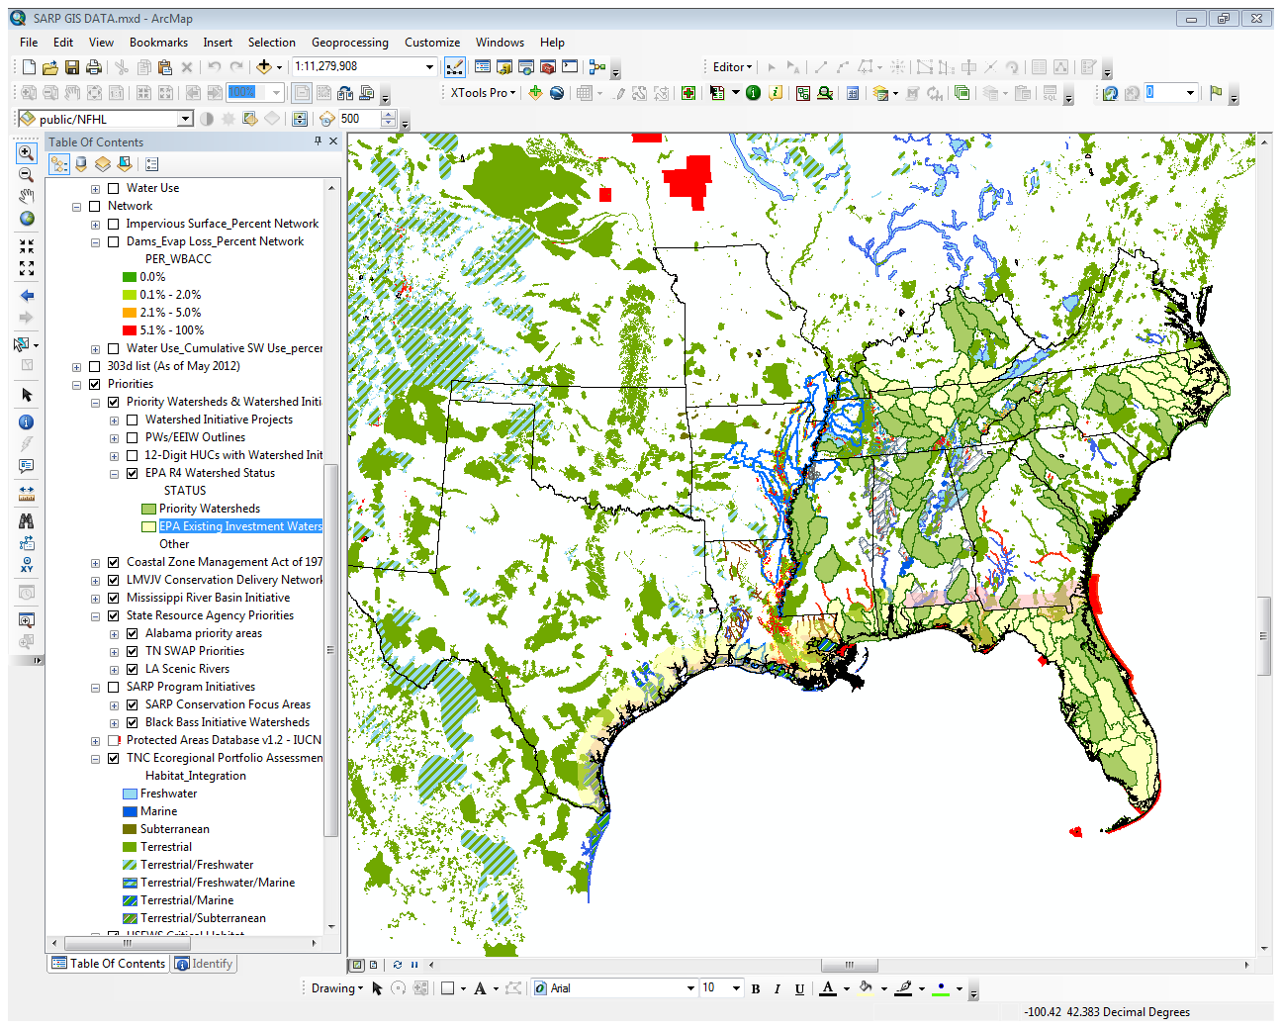
Compilation of Partner’s Data

Slide 18
Data Application

Slide 19
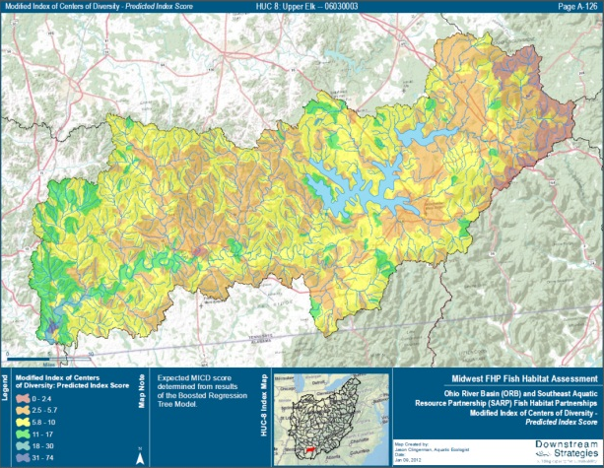
Tennessee/Cumberland Habitat Assessment

Slide 20
Now, we add in predicted urbanization land use change at the year 2060. All of the land in this layer has an 80% chance of becoming urban by 2060. The legend will tell you which current land use type is being converted to urban.

Slide 21
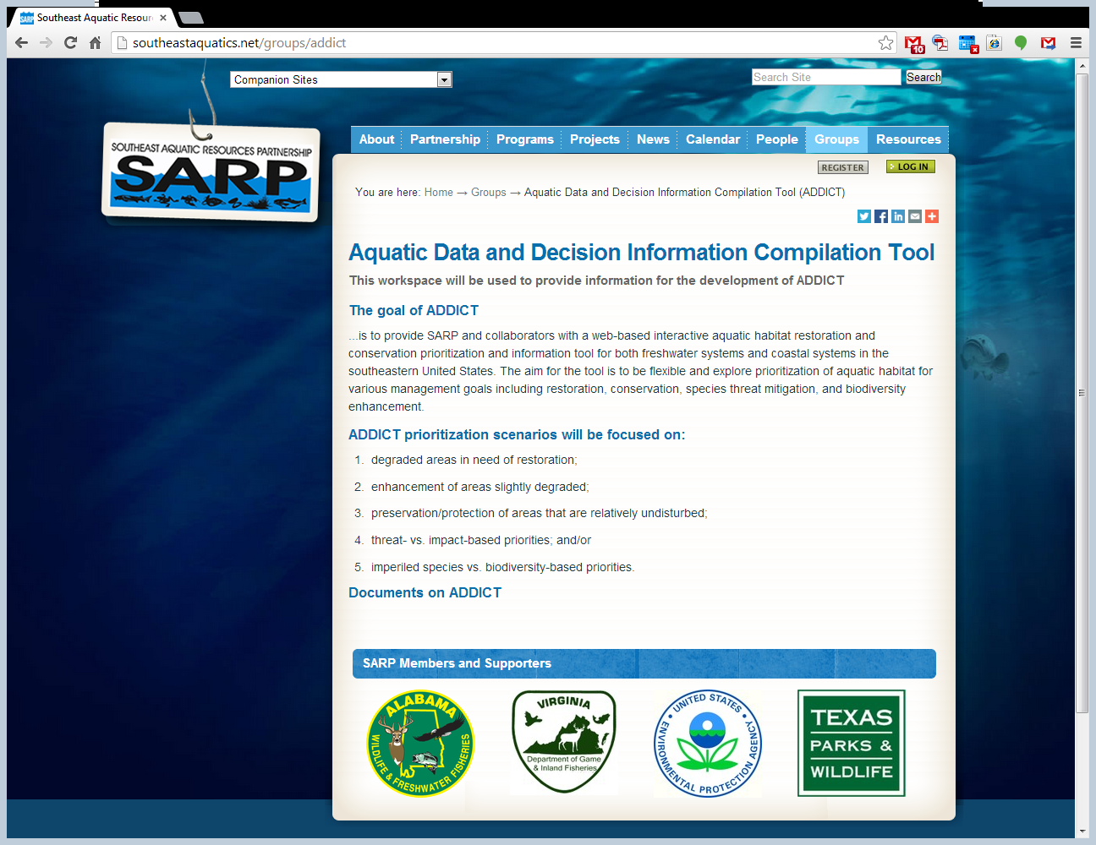
Aquatic Data and Decision Information Compilation Tool

Slide 22
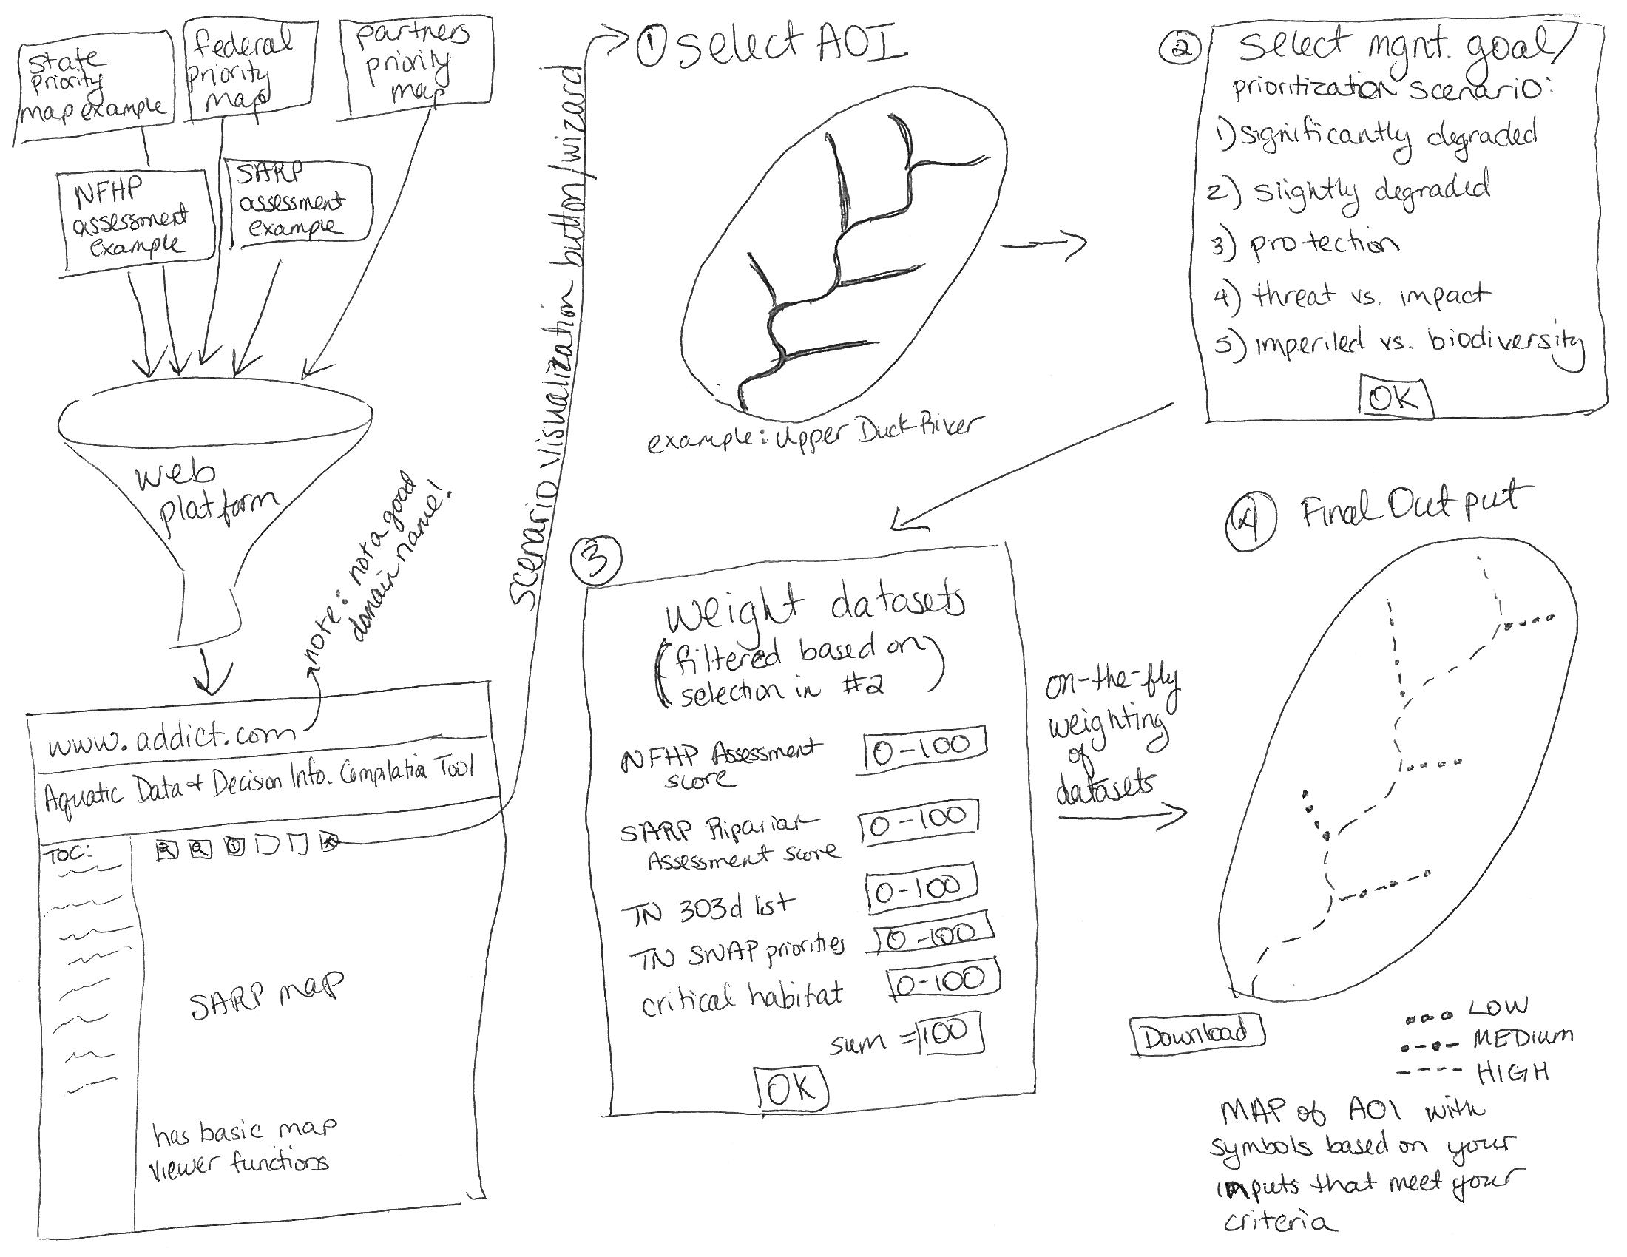
Custom Scenario Visualization Tool Workflow

Slide 23
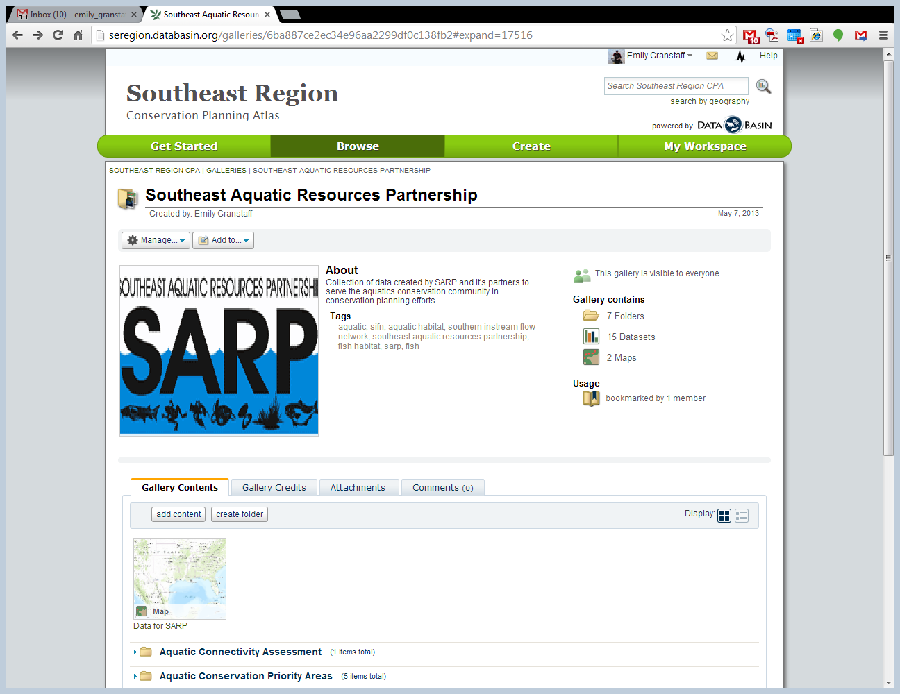
LCC’s Conservation Planning Atlases

Slide 24
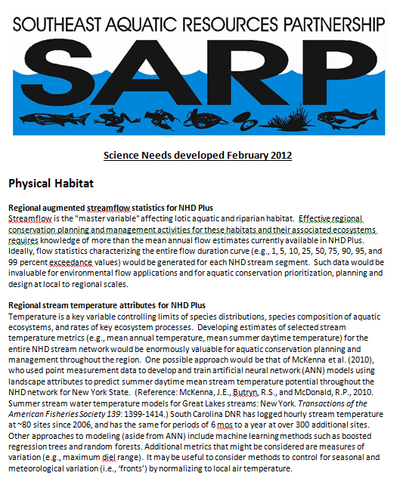
SARP Science Needs

